Slide 1
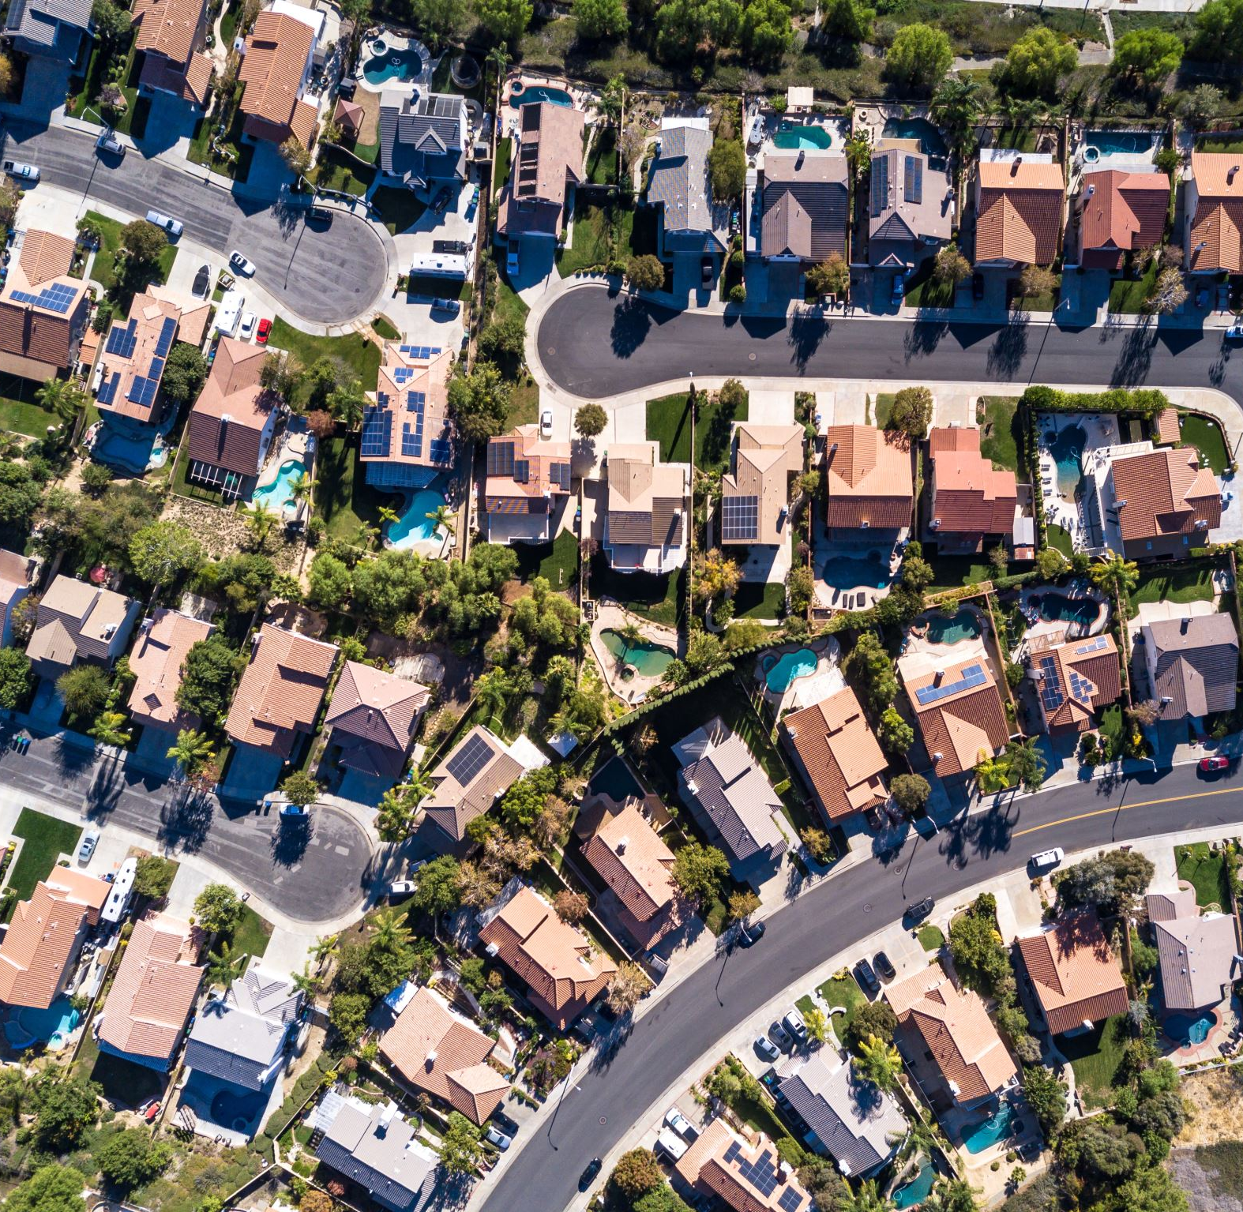
Analysis of San Francisco Housing Market
Methods and tools to act against displacement and gentrification
Pietro Bogani, Tomaso Castellani, Sara Tonazzi
8 CFU 8 CFU 5 CFU

Slide 2
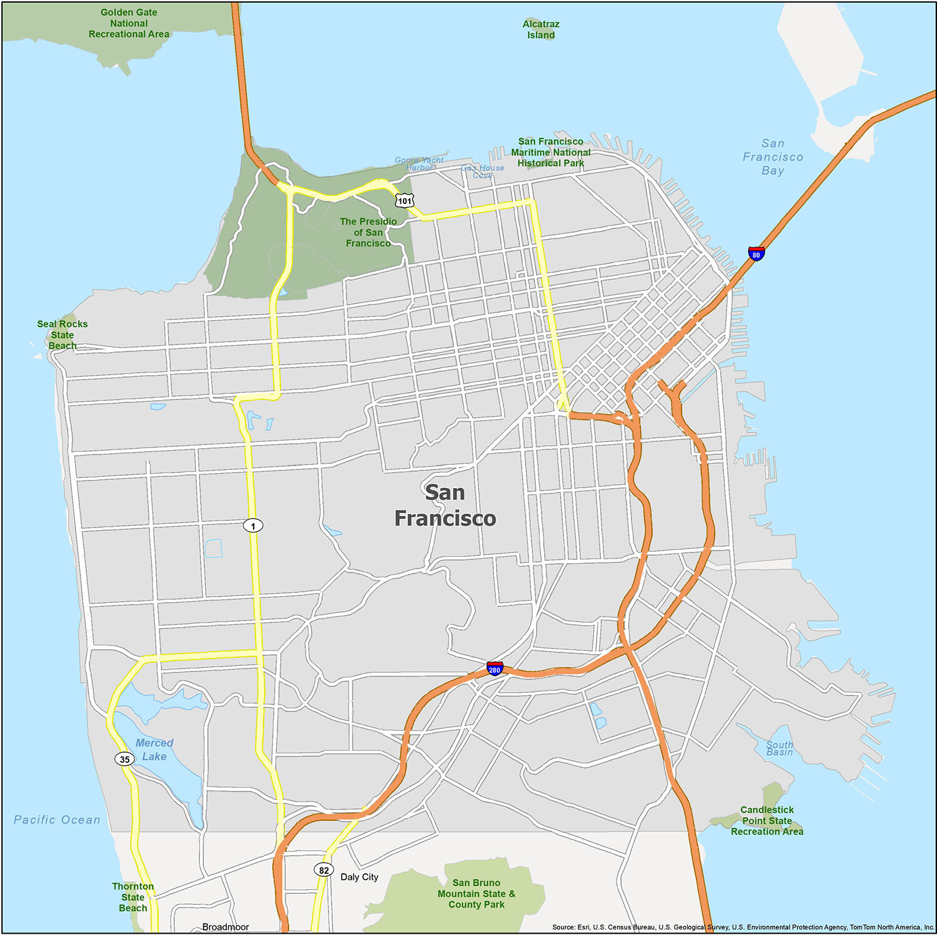
The problem
Gentrification and displacement
The process whereby the character of a urban area is changed by wealthier people moving in, displacing current inhabitants in the process.
Gentrification in San Francisco has increased significantly since the 1990s, driven by a strong demand for tech workers from local startups and Silicon Valley companies.
This process affected negatively the social demographic structure of the city, as SF was becoming the most expensive city in the US.

Slide 3
Goals
Use statistical methods and develope models to understand how the SF housing market has changed in the last 15 years and which factors drived these changes.
Provide to the local government tools to tackle the problem of gentrification and displacement.
Further validate previous papers on the topic.

Slide 4
Dataset

Slide 5




Rent
Evictions
Dataset
Parcels
&
Neighborhood
Constructions

Slide 6
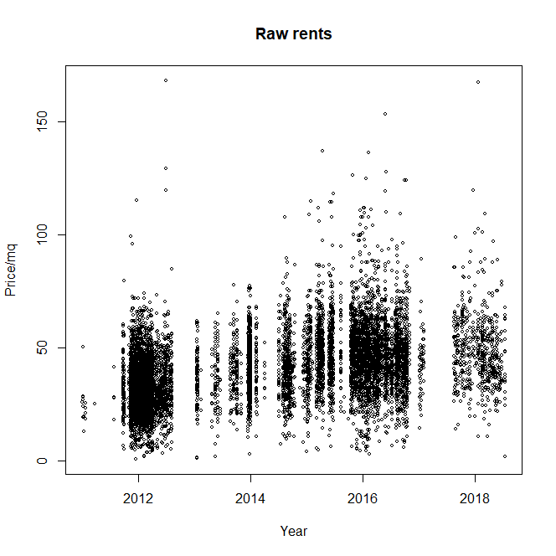
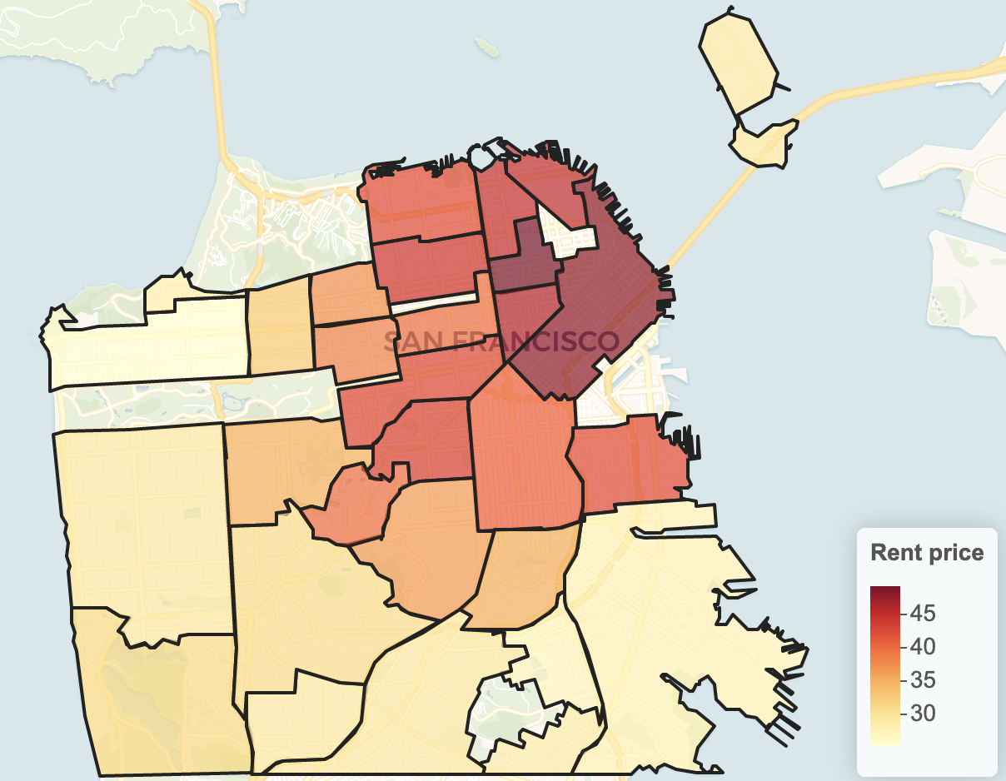
Datasets
Rent
Source: Craiglist.com
Main information:
Neighborhood
Price/mq
Date of the advertisement

Slide 7

Datasets
Source: SF government
(datasf.org)
Main information:
Neighborhood
Date
Evictions

Slide 8
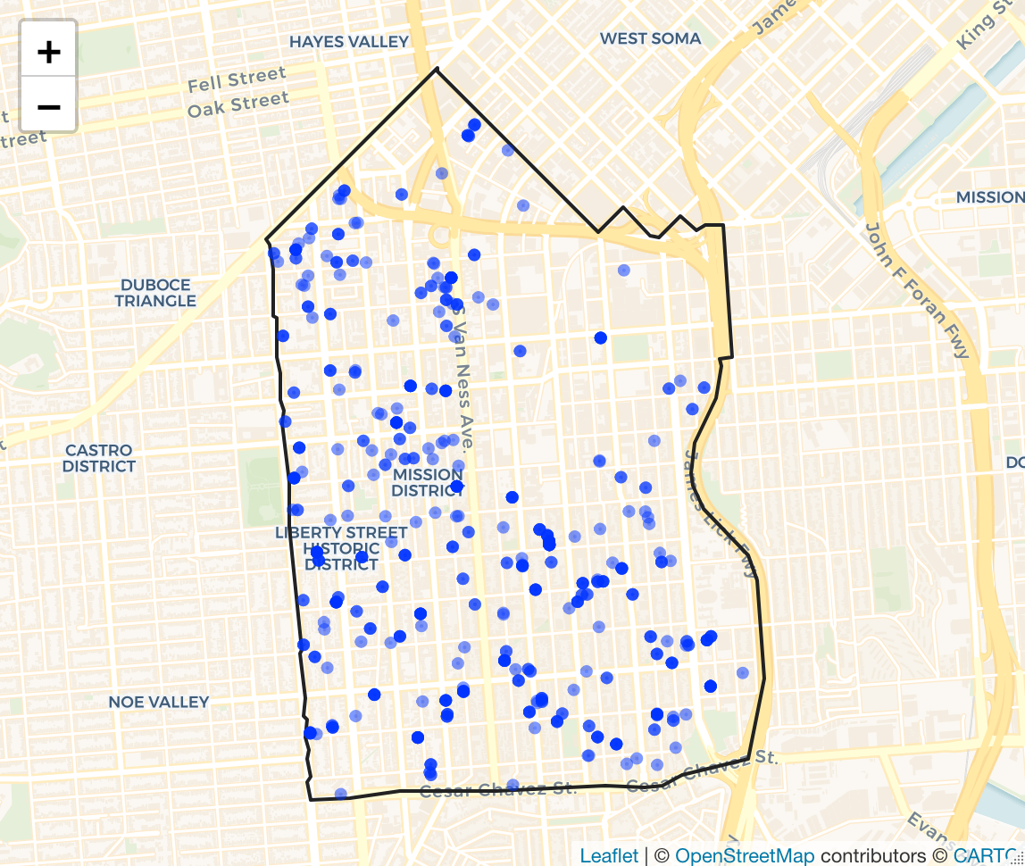
Datasets
Source: SF government (datasf.org)
Main information:
Address (geocoded to coordinates)
Date of permit emission
Existing and proposed housing units
Constructions

Slide 9
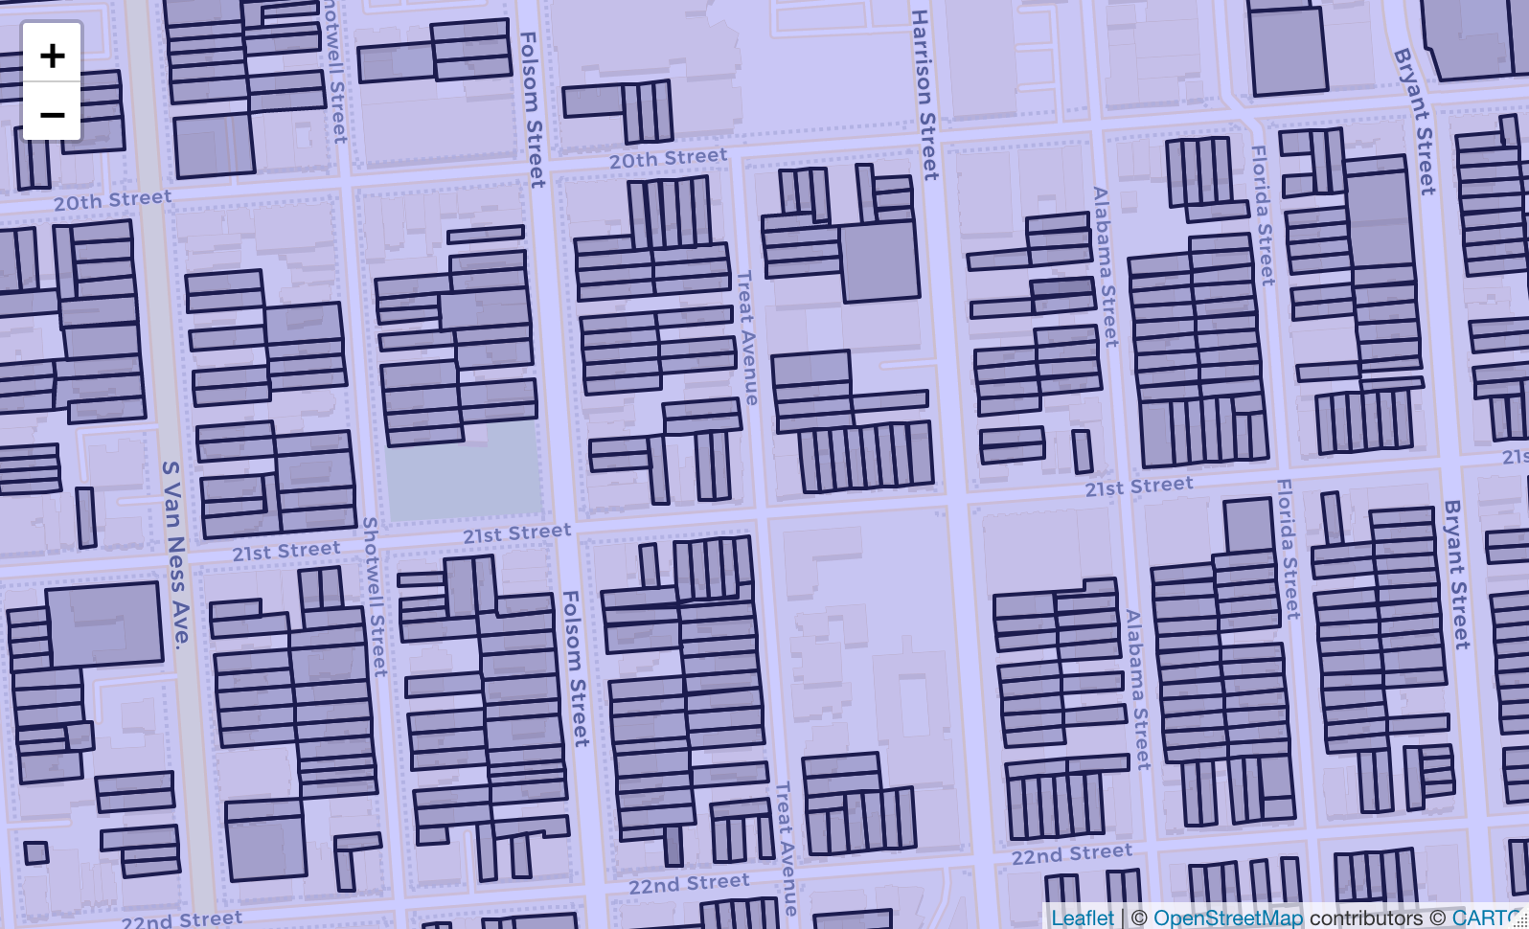

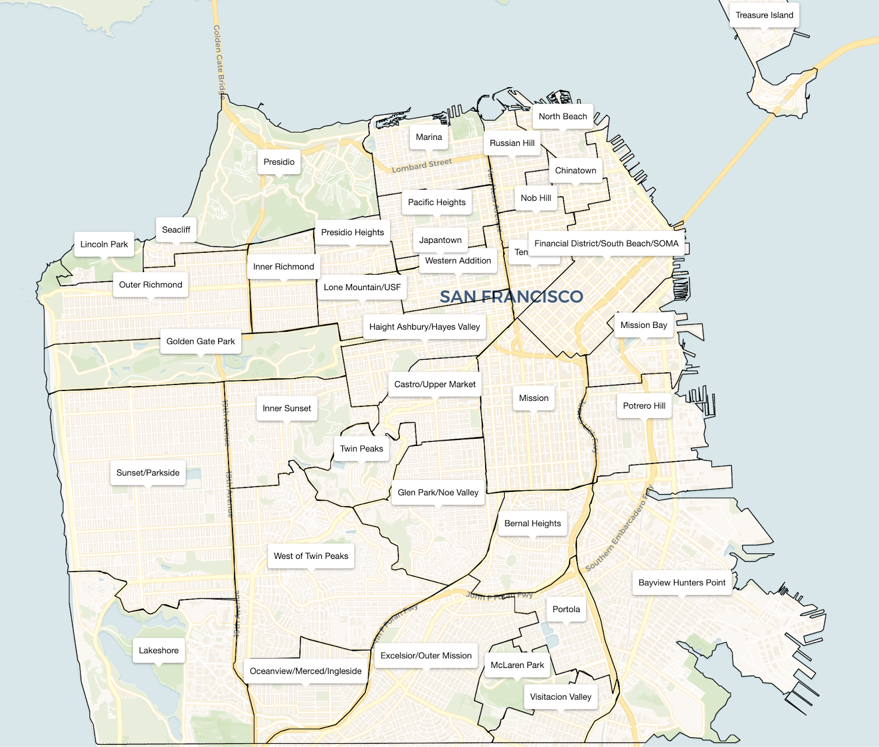
Datasets
Source: SF government (datasf.org)
Main information:
Latitude and longitude of the vertices of the parcel
Number of house units for each parcel
Parcels
&
Neighborhoods

Slide 10
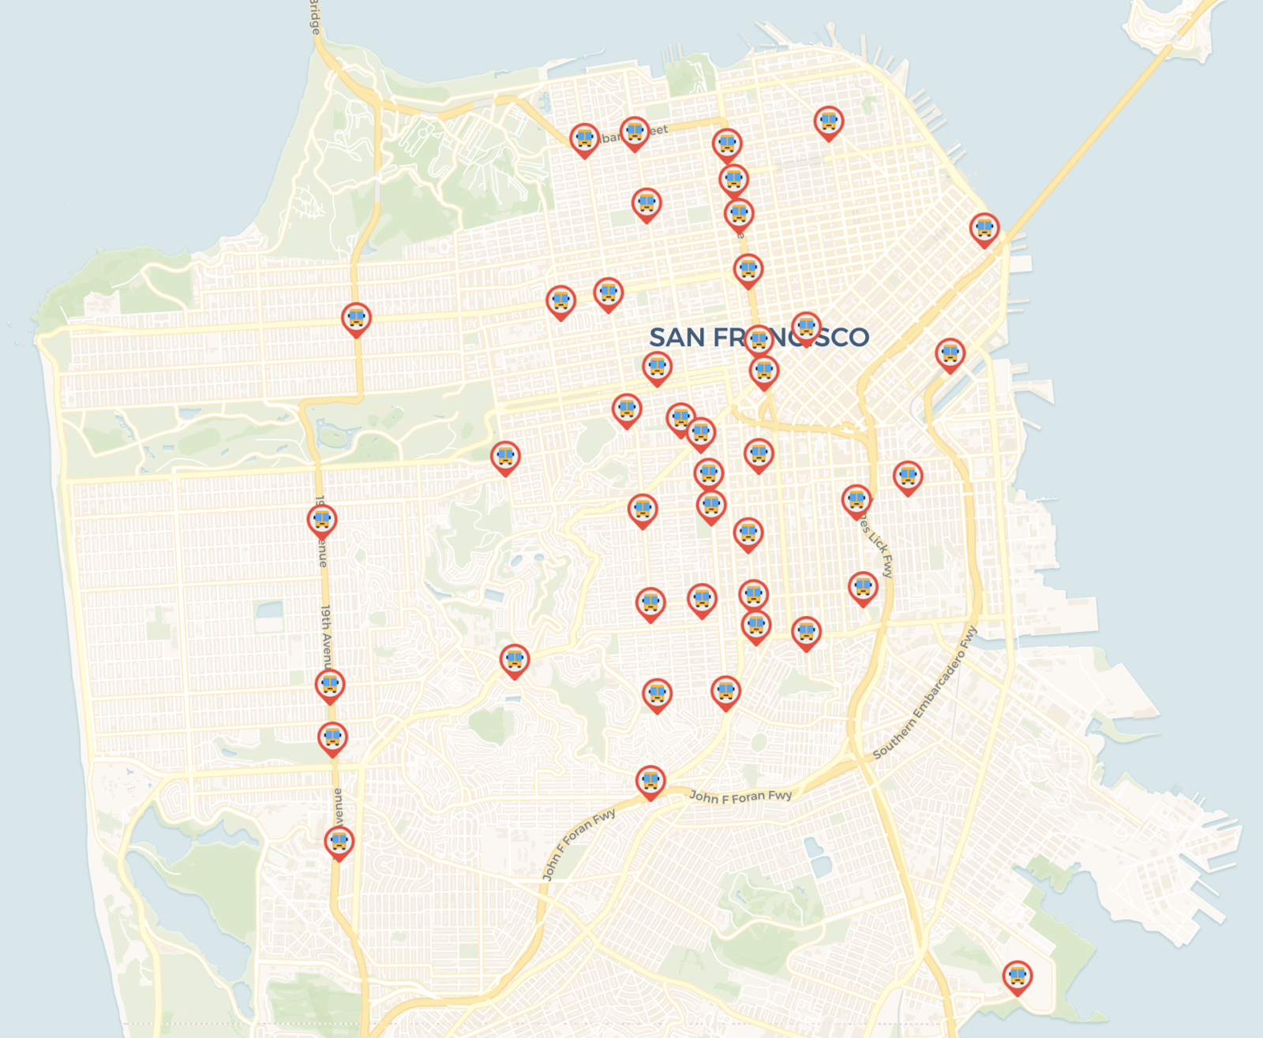

Datasets
Tech companies
Bus
Source: Stamen Design
Main information:
Latitude and longitude of the estimated bus stop

Slide 11
Exploratory analysis (Trends analysis?)

Slide 12
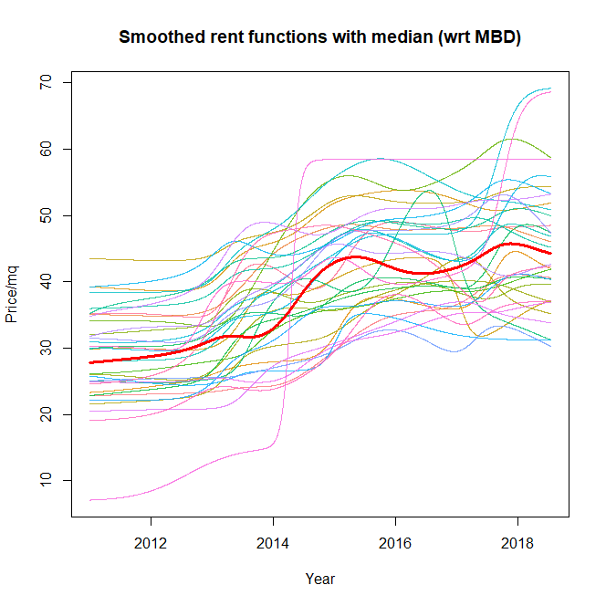
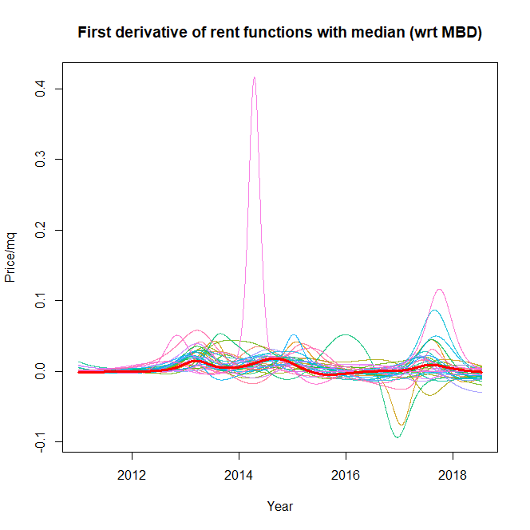
Rent
functions

Slide 13
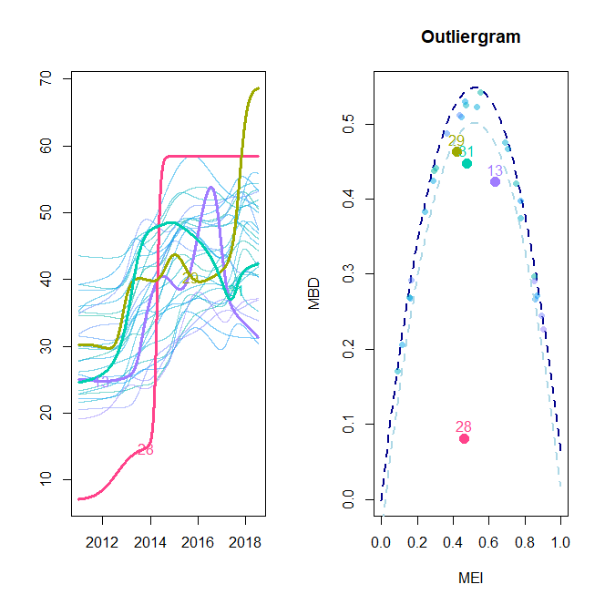
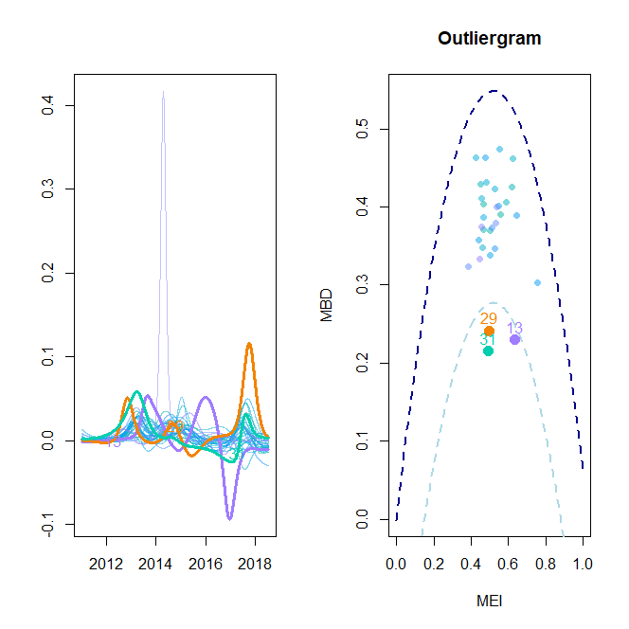
Outlier detection
Shape outliers : we remove only Tresure Island (28), an artificial island scarcely inhabited

Slide 14
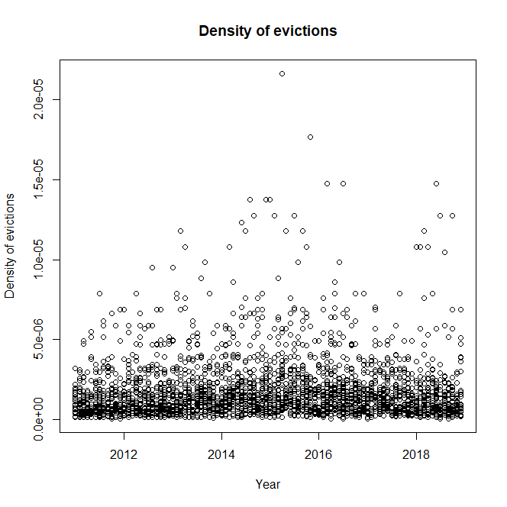
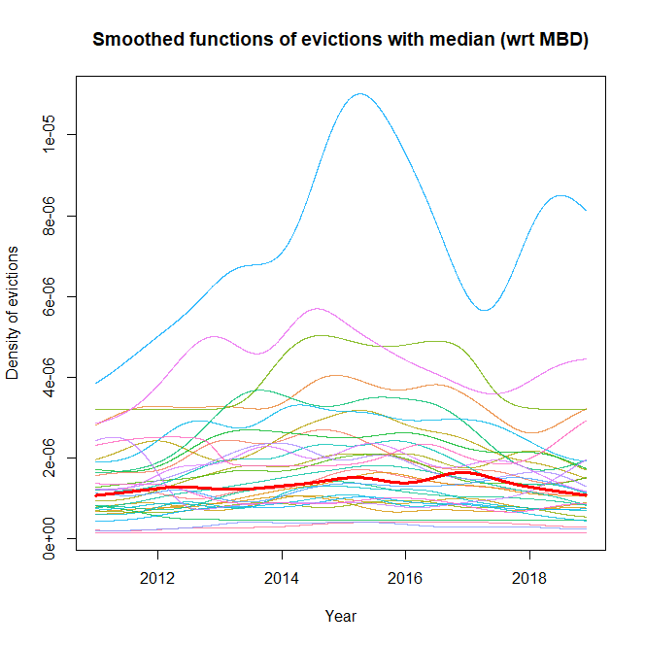
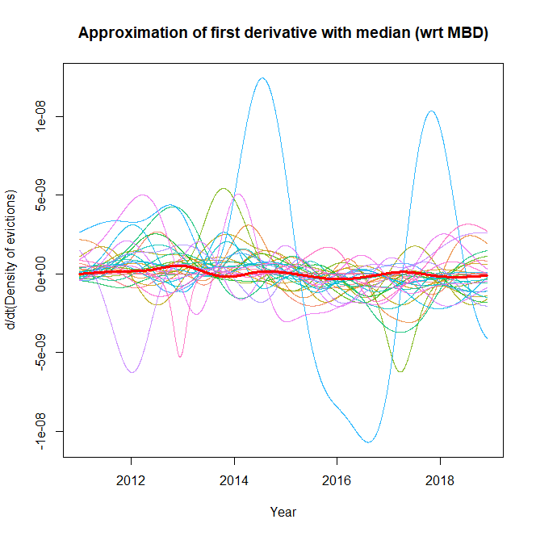
Eviction
density functions

Slide 15
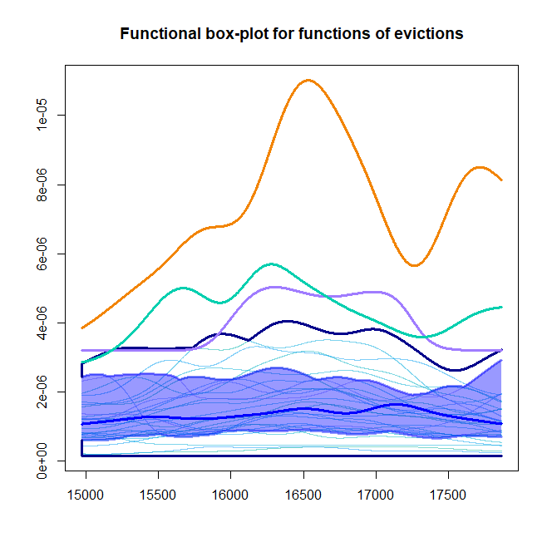
Outlier
detection
Magnitude outliers : Japantown, Tenderloin and Nob Hill

Slide 16
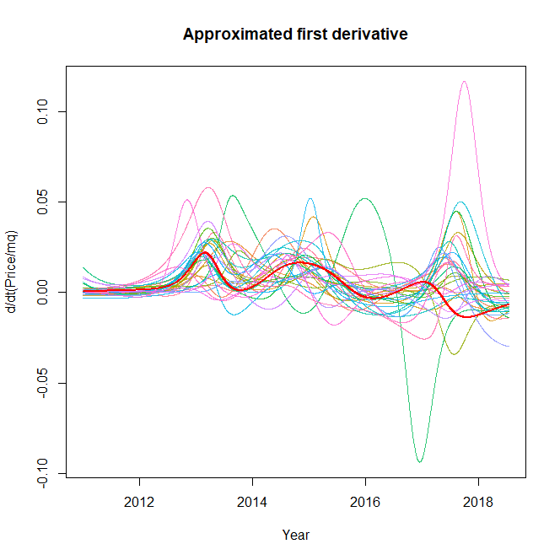
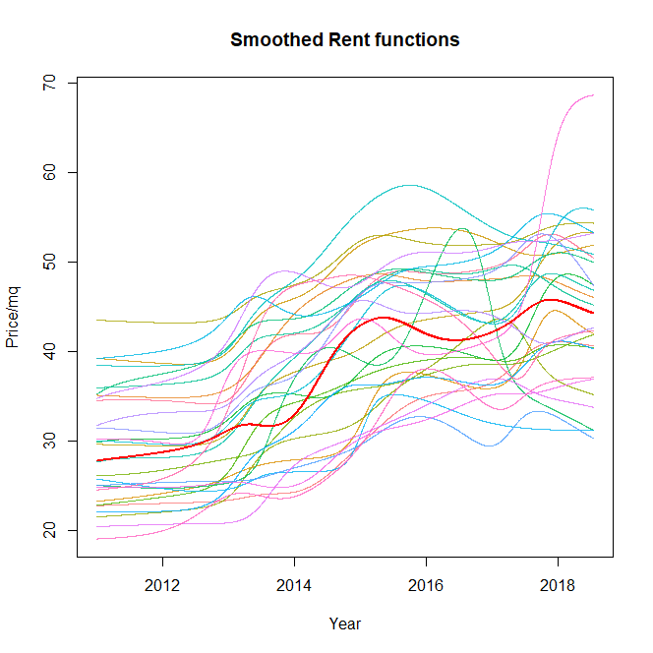
Rent functions
Eviction density functions

Slide 17
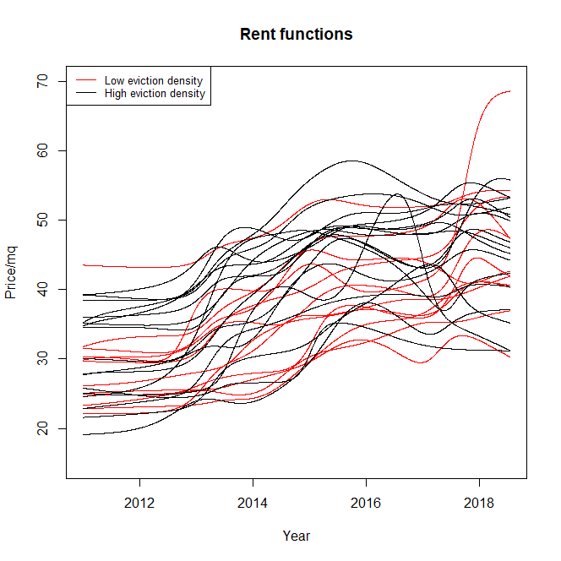
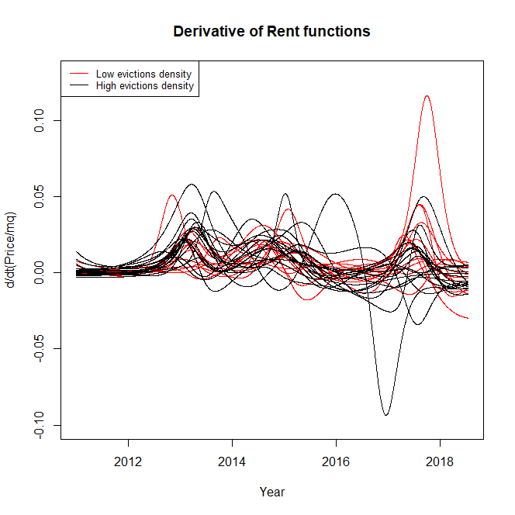
Tests on
rent functions
based on evictions
P-value : 0.378
P-value : 0.748
There is not significant difference

Slide 18
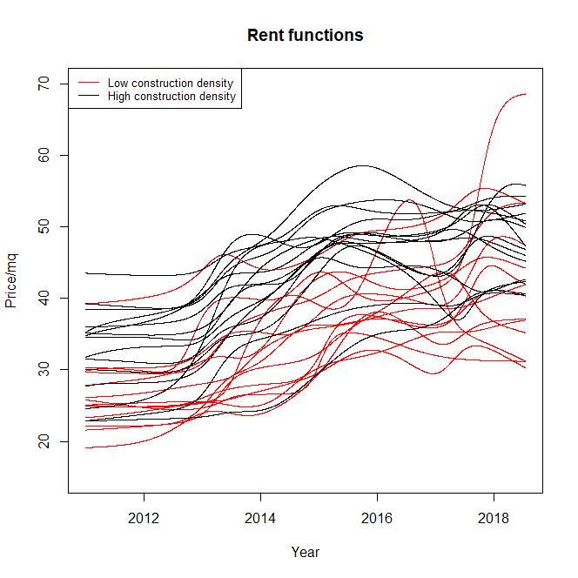
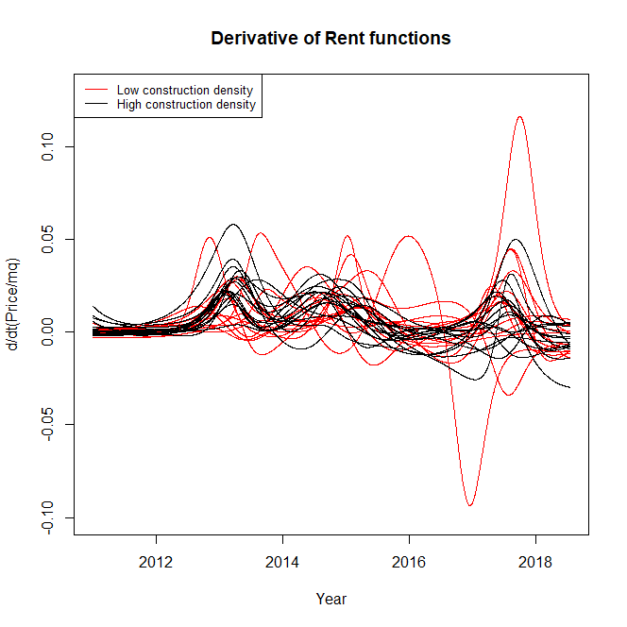
Tests on
rent functions
based on
constructions
P-value : 0.031
P-value : 0.561
There is difference for the rent functions but not in the derivatives

Slide 19
Constructions effect on evictions

Slide 20
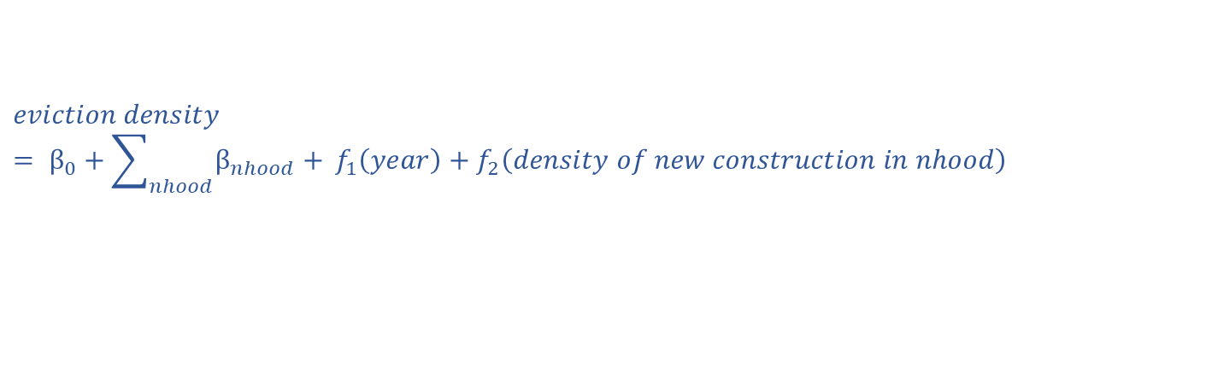
Neighborhood
granularity
$$eviction density = β_{0}+\sum_{nhood}{β_{nhood}+ }f_{1}\left(year\right)+f_{2}\left(density of new construction in nhood\right)$$
Da definire i plot da mettere

Slide 21
Constructions effect on rents

Slide 22
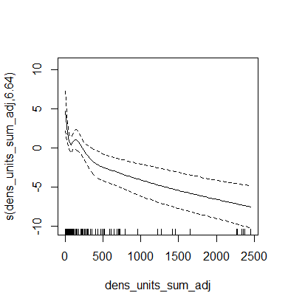
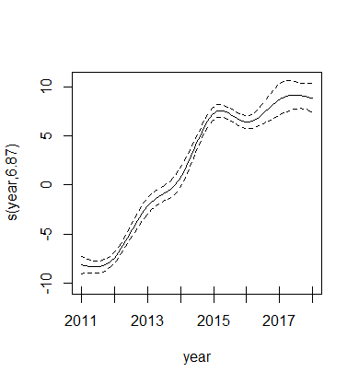
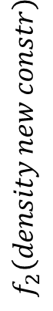
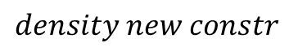
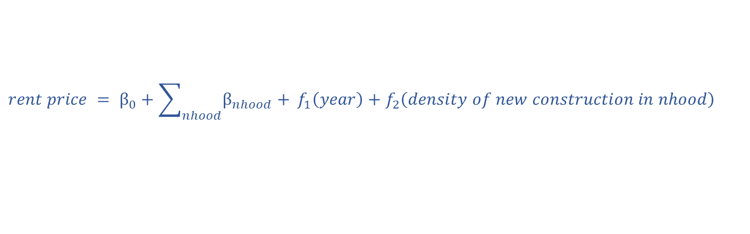


Neighborhood
granularity
$$rent price = β_{0}+\sum_{nhood}{β_{nhood}+ }f_{1}\left(year\right)+f_{2}\left(density of new construction in nhood\right)$$
$$f_{2}\left(density new constr\right)$$
$$f_{1}\left(year\right)$$
$$density new constr$$
$$year$$

Slide 23
Gaussian Kernel
Smoothing
2D
Average price
in each neighborhood
Gaussian Kernel Regression based on the coordinates of the centroids of the neighborhoods
Single advertisements
Improvement : consider the small fraction of observation with coordinates as observation, adding proper weights

Slide 24
Gaussian Kernel
Smoothing
2D
Qui metterei le animazioni a confronto!
Nhood level vs continuum level

Slide 25
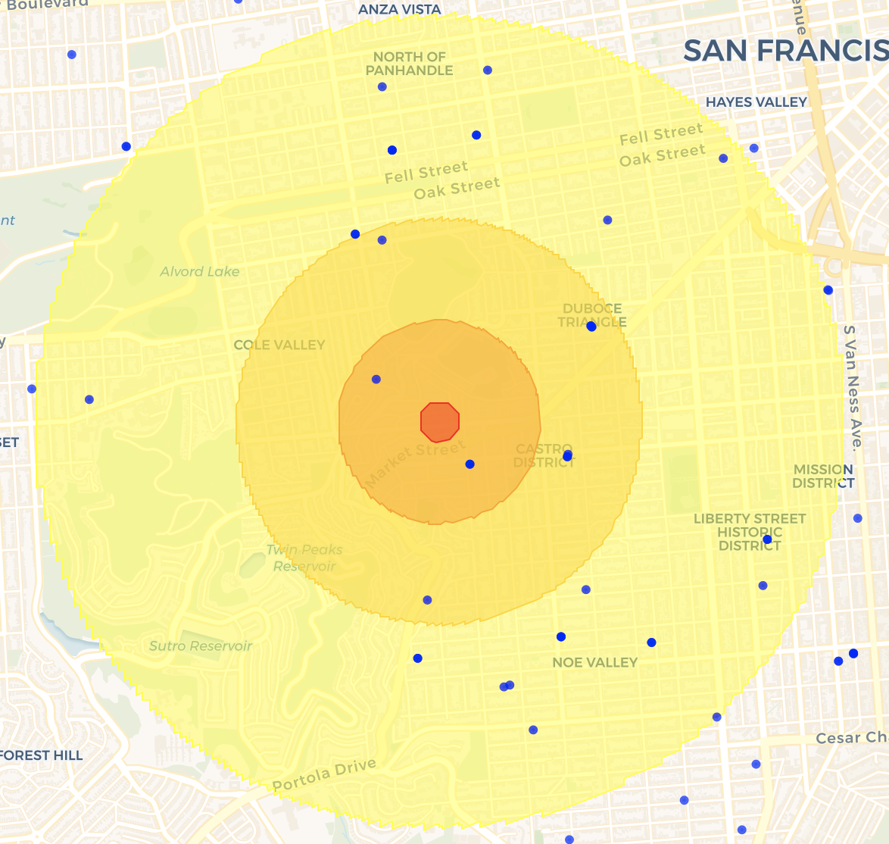
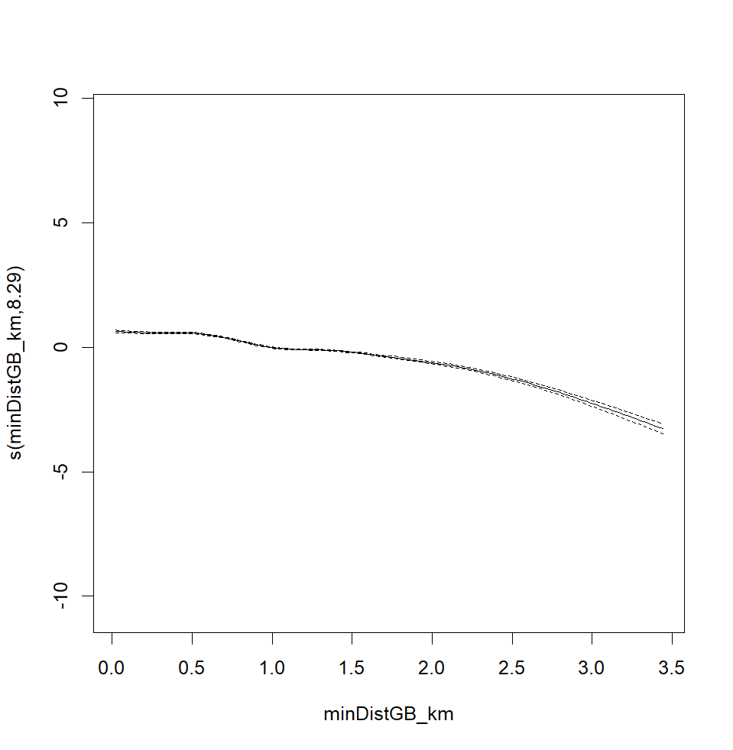
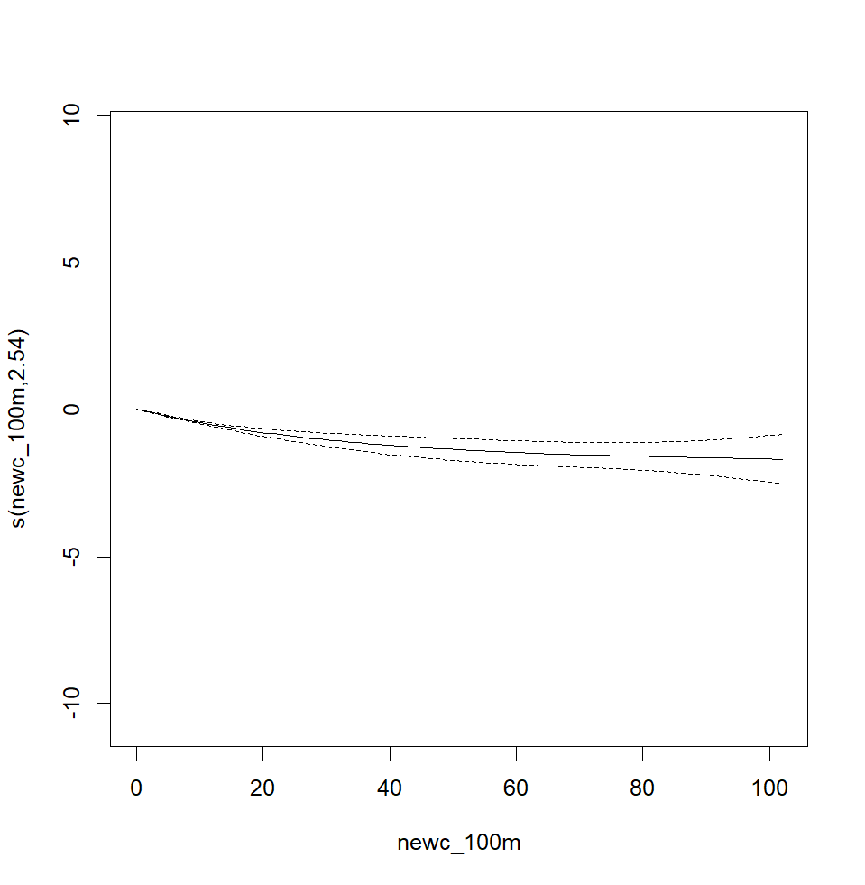
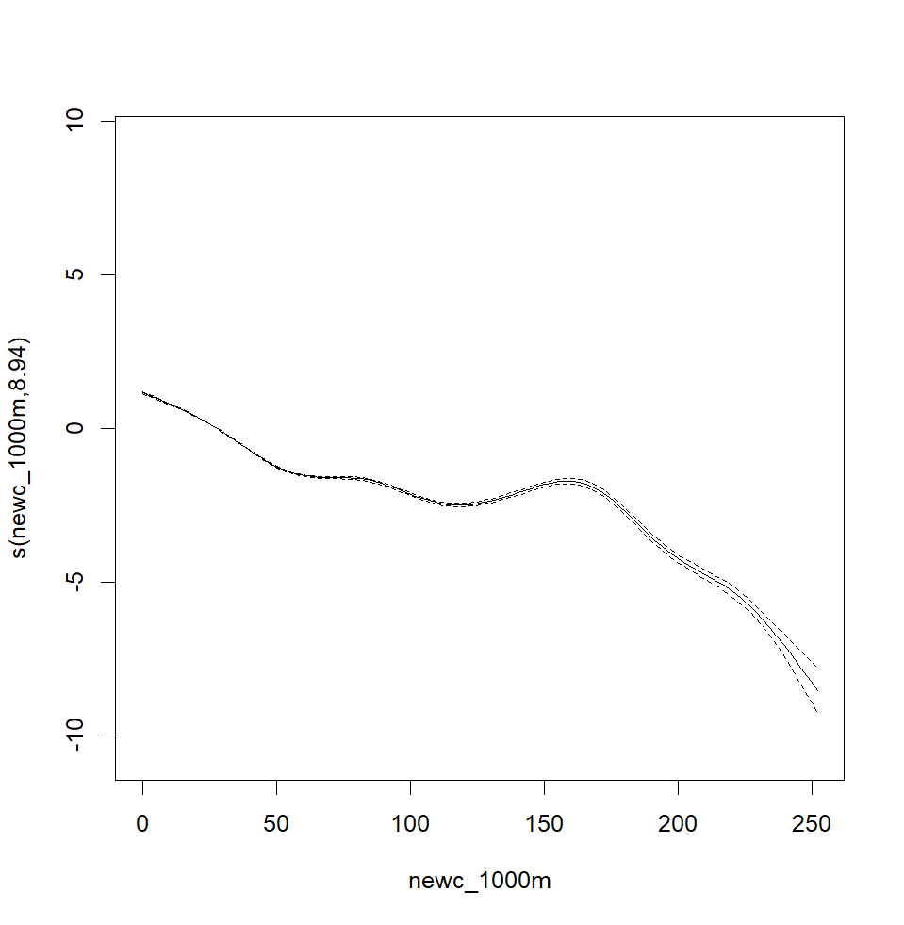



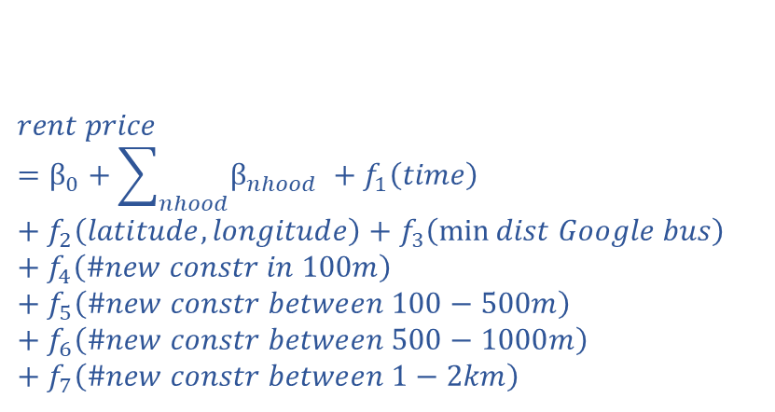



$$rent price=β_{0}+\sum_{nhood}{β_{nhood} }+f_{1}\left(time\right)+f_{2}\left(latitude,longitude\right)+f_{3}\left(\min{dist Google bus}\right)+f_{4}\left(\#new constr in 100m\right)+f_{5}\left(\#new constr between 100−500m\right)+f_{6}\left(\#new constr between 500−1000m\right)+f_{7}\left(\#new constr between 1−2km\right)$$
Parcels
granularity
$$f_{3}\left(min dist GB\right)$$
$$f_{4}\left(\#new constr 100m\right)$$
$$f_{4}\left(\#new constr 1000m\right)$$
$$min dist GB$$
$$\#new constr 100m$$
$$\#new constr 1000m$$

Slide 26
Conclusions

Slide 27
Conclusions
Improvements
&
Ideas
Collect located rents and evictions
Study the effect of constructions as function of time
Separate the effect of different types of constructions (affordable and not affordable)

Slide 28
Extra

